Slide 1
ARDUINO-BASED DUAL-AXIS SOLAR TRACKER WITH WEATHER MONITOR

Slide 2
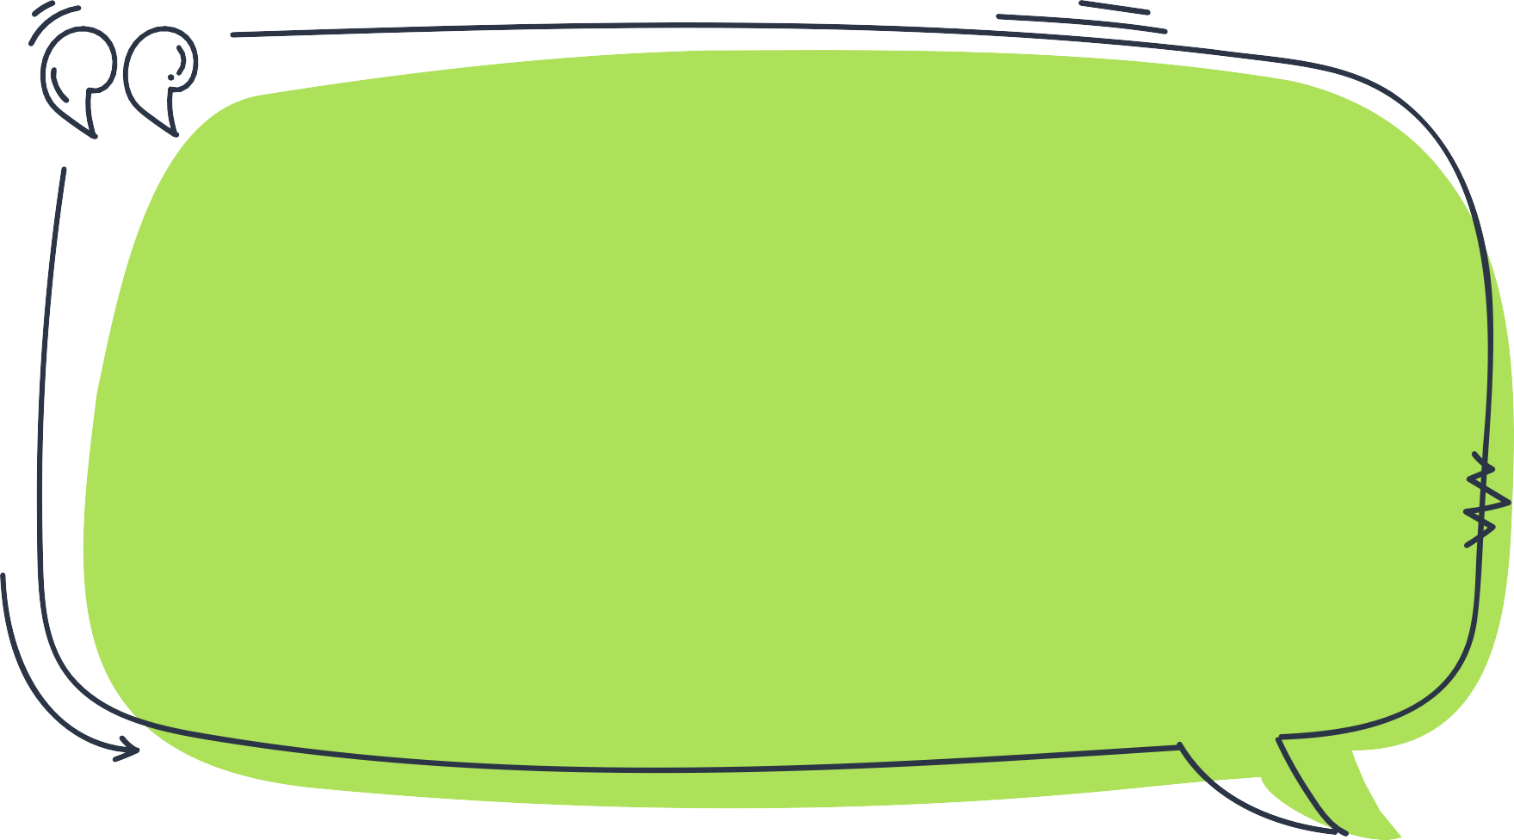
PROJECT NAME: SOLACE

Slide 3




MEET THE MEMBERS OF GROUP 6
Ankur Das (GR) (111122013)
JOHAN SURESH (111122049)
LAKSHYA TIWARI (111122063)
PANCHAM DEVAM URMIL (111122079)

Slide 4
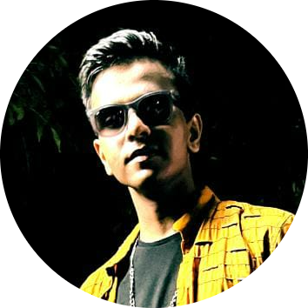

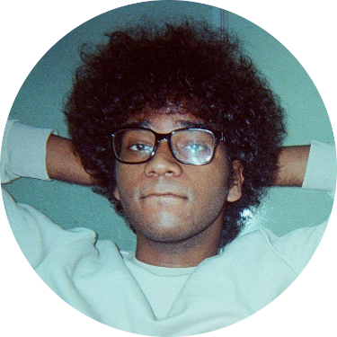
MEET THE MEMBERS OF GROUP 6
PRANAV GAJENDRA (111122087)
SREE RAM PM (111122121)
SRIVISHNU (111122125)

Slide 5
INTRODUCTION

Slide 6
PROJECT GOALS & OBJECTIVES
This project aims to optimize the performance of a solar PV system by maximizing the efficiency through continuous tracking of the position the sun and accordingly adjusting the orientation of the panels throughout the day. This causes the system can capture more amount of direct solar radiation which is normal to the panel.
In addition to this, it also aims to monitor weather conditions such as temperature, humidity and rainfall. The analysis of this data will trigger the shutdown of the system in case of extreme weather conditions like high-wind speeds, hailstorms, or lightning strikes which can potentially damage the solar panels, tracking system, and other components. This further ensures longevity of the system thereby significantly reducing maintenance costs.
Apart from these aspects, this project also creates awareness and promotes sustainability by encouraging the use of solar power. By increasing the efficiency of solar panels, the system can help reduce reliance on non-renewable energy sources and promote a cleaner, greener and more sustainable future.

Slide 7

MOTIVATION BEHIND NAMING THE PROJECT
"SOLACE" is an acronym which stands for "Solar Orientation and Localized Atmospheric Conditions Evaluation." This acronym reflects the system's ability to track the sun for optimal solar panel positioning, as well as its capability to monitor localized atmospheric conditions for ensuring longevity of the system. It implies that the system evaluates atmospheric conditions in the immediate vicinity to gather data and make informed decisions about solar panel orientation. The acronym "SOLACE" encapsulates the system's core functionalities and highlights its focus on solar tracking and weather monitoring for maximum performance.

Slide 8
CHALLENGES FACED IN CONVENTIONAL SOLAR PANELS
Conventional solar panels have been widely used for electricity generation, but they have faced several challenges. One of the major challenges is their efficiency in converting sunlight into electricity. The maximum theoretical efficiency of a solar panel is around 33% while the practical efficiency of most commercially available solar panels is between 15% and 20%.
Another challenge is their fixed orientation, which means that they only capture sunlight optimally for a limited period of the day while during other periods, the solar panels are not as effective in generating electricity, leading to a loss in potential energy production.
Yet, another significant challenge is that conventional solar panels are often impacted by weather conditions like clouds, rain, and snow can reduce the amount of sunlight that reaches the solar panels, reducing their overall efficiency and increasing maintenance costs. High temperatures can also impact solar panel efficiency by causing a reduction in output and potentially damaging the panels.

Slide 9
HOW THIS PROJECT CAN ADDRESS THESE CHALLENGES?
To address these challenges, solar tracking systems have been developed to improve the efficiency of solar panels. These systems use motors and sensors to adjust the angle and orientation of the solar panels continuously, ensuring that they are always aligned with the sun's position. As a result, solar tracking systems can increase the efficiency of solar panels by up to 30%.
Furthermore, weather monitoring can play an important role in improving the efficiency and safety of solar energy generation. By providing real-time information on local weather conditions, such as wind speed, temperature, and cloud cover, solar energy systems can be optimized to generate electricity more efficiently and safely. For instance, if the weather is cloudy or the wind speed is too high, the solar tracking system can adjust the angle of the solar panels to minimize the risk of damage or failure.

Slide 10
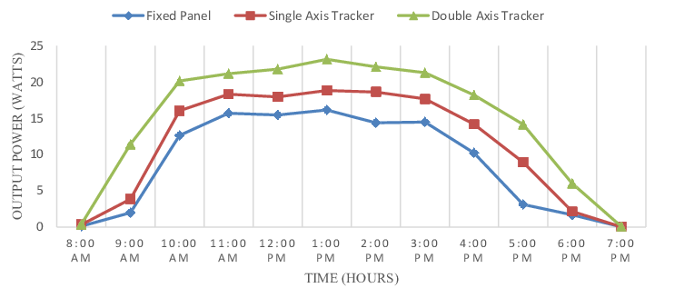
Graphical variation of power output v/s time

Slide 11
Why is this concept unique?
The uniqueness of this concept lies in its ability to combine solar tracking and weather monitoring to address the challenges faced by traditional solar panels,
This concept represents an innovative and effective approach to promoting sustainable energy production thereby making solar power a more reliable and sustainable energy source.
Furthermore, this project has the potential to make solar power more accessible and effective for a wider range of users,

Slide 12
Theory & data analysis

Slide 13
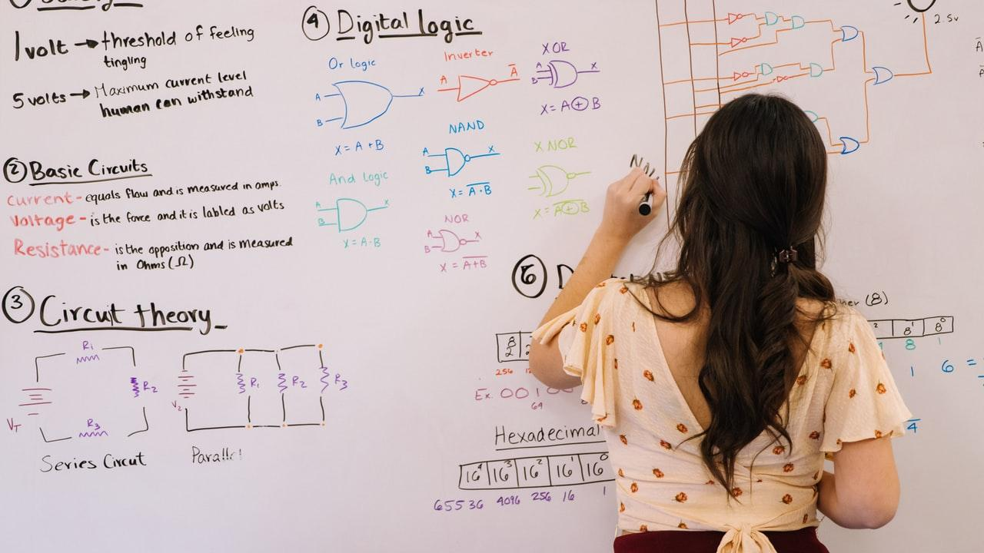
Mathematical formulations
The mathematical formulation used in solar tracking is based on the principles of celestial mechanics, which describe the motion of objects in space. Specifically, the position of the sun relative to the tracker can be calculated using the equations for the altitude and azimuth angles of the sun. These calculations allow the solar tracker to determine the precise position of the sun in the sky and adjust the position of the solar panels accordingly to maximize the amount of solar energy they can capture.

Slide 14
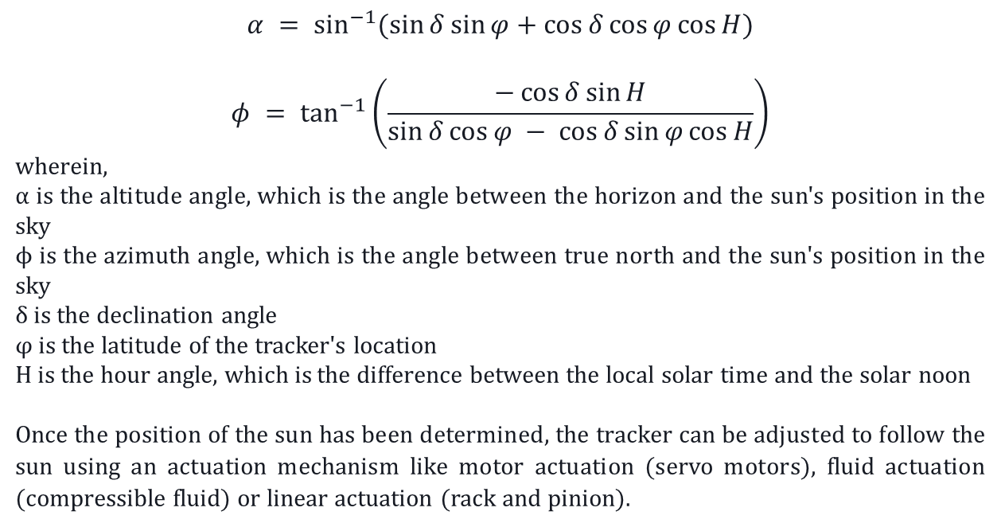
$$α = \sin^{−1}{(\sin{δ}\sin{φ}+\cos{δ}\cos{φ}\cos{H})}$$
$$φ = \tan^{−1}\left(\frac{−\cos{δ}\sin{H}}{\sin{δ}\cos{φ} − \cos{δ}\sin{φ}\cos{H}}\right)$$
wherein,
$α$ is the altitude angle, which is the angle between the horizon and the sun's position in the sky
ϕ is the azimuth angle, which is the angle between true north and the sun's position in the sky
δ is the declination angle
φ is the latitude of the tracker's location
H is the hour angle, which is the difference between the local solar time and the solar noon
Once the position of the sun has been determined, the tracker can be adjusted to follow the sun using an actuation mechanism like motor actuation (servo motors), fluid actuation (compressible fluid) or linear actuation (rack and pinion).

Slide 15
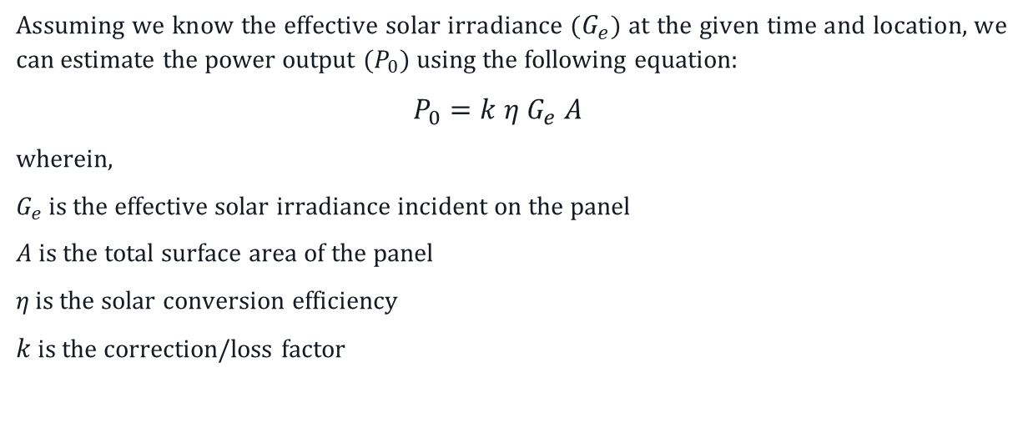
SOLAR PANEL OUTPUT EQUATION
Assuming we know the effective solar irradiance ($G_{e}$) at the given time and location, we can estimate the power output ($P_{0}$) using the following equation:
$$P_{0}=k η G_{e} A$$
wherein,
$G_{e}$ is the effective solar irradiance incident on the panel
$A$ is the total surface area of the panel
$η_{ }$is the solar conversion efficiency
$k$ is the correction/loss factor

Slide 16
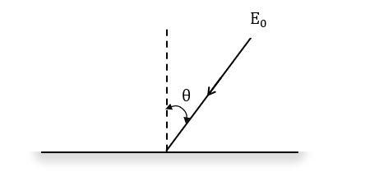
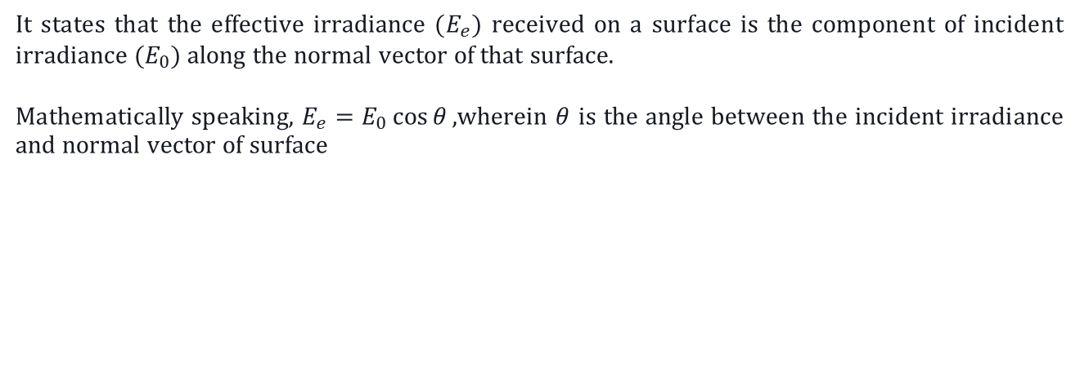
LAMBERT’s COSINE LAW
It states that the effective irradiance ($E_{e}$) received on a surface is the component of incident irradiance ($E_{0}$) along the normal vector of that surface.
Mathematically speaking, $E_{e}=E_{0}\cos{θ},$wherein $θ$ is the angle between the incident irradiance and normal vector of surface

Slide 17
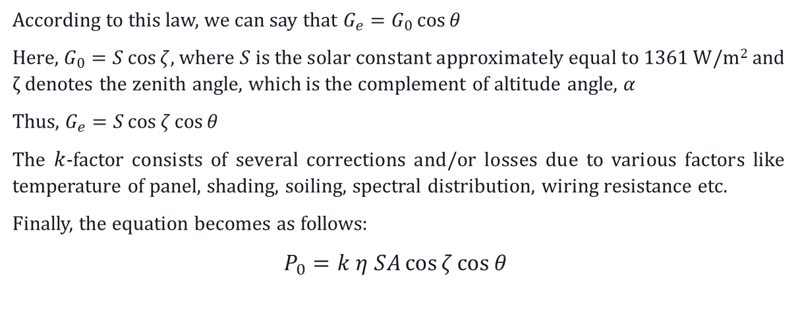
According to this law, we can say that $G_{e}=G_{0}\cos{θ}$
Here, $G_{0}=S\cos{ζ}$, where $S$ is the solar constant approximately equal to 1361 W/m² and ζ denotes the zenith angle, which is the complement of altitude angle, $α$
Thus, $G_{e}=S\cos{ζ}\cos{θ}$
The $k$-factor consists of several corrections and/or losses due to various factors like temperature of panel, shading, soiling, spectral distribution, wiring resistance etc.
Finally, the equation becomes as follows:
$P_{0}=k η SA\cos{ζ\cos{θ}}$

Slide 18
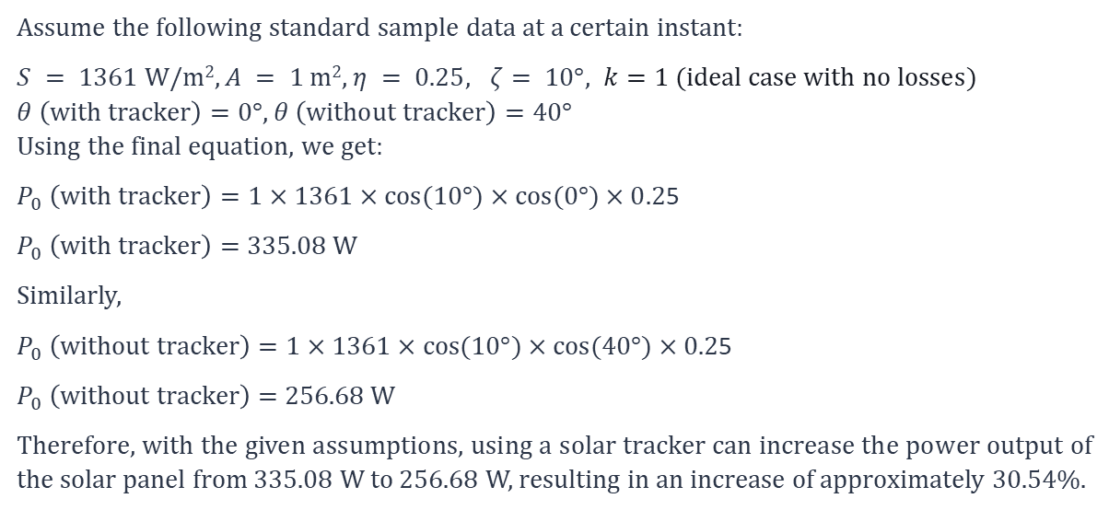
CALCULATION OF POWER OUTPUT
Assume the following standard sample data at a certain instant:
$S = 1361$ W/m²$, A = 1$ m², $η = 0.25, ζ= 10°, k=1 (ideal case with no losses)$
$θ \left(with tracker\right)=0°$, $θ \left(without tracker\right)=40°$
Using the final equation, we get:
$P_{0} \left(with tracker\right)=1×1361×cos(10°)×cos(0°)×0.2$5
$P_{0} \left(with tracker\right)=$ 335.08 W
Similarly,
$P_{0} \left(without tracker\right)=1×1361×cos(10°)×cos(40°)×0.2$5
$P_{0} \left(without tracker\right)=$ 256.68 W
Therefore, with the given assumptions, using a solar tracker can increase the power output of the solar panel from 335.08 W to 256.68 W, resulting in an increase of approximately 30.54%.

Slide 19
Graphical variations

Slide 20
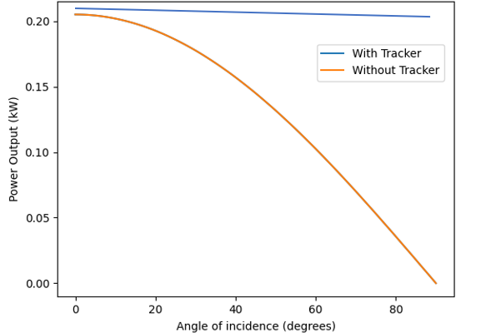
POWER OUTPUT V/S INCIDENT ANGLE
Observation: The power output is higher with the tracker than without it for all angles of incidence, but that difference becomes more prominent at high angles of incidence.

Slide 21
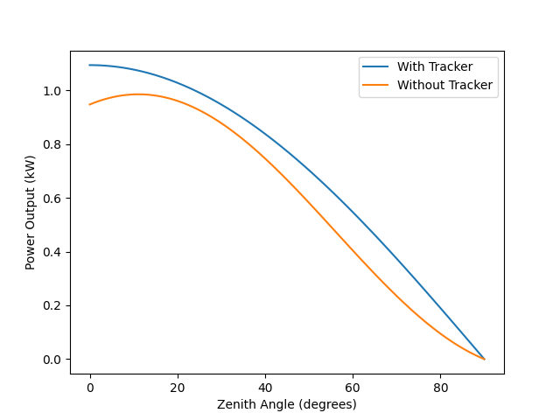
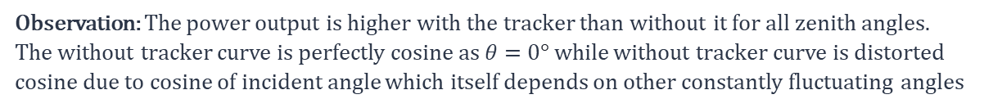
POWER OUTPUT V/S SOLAR IRRADIANCE
Observation: The power output is higher with the tracker than without it for all zenith angles. The without tracker curve is perfectly cosine as $θ=$0$°$while without tracker curve is distorted cosine due to cosine of incident angle which itself depends on other constantly fluctuating angles

Slide 22
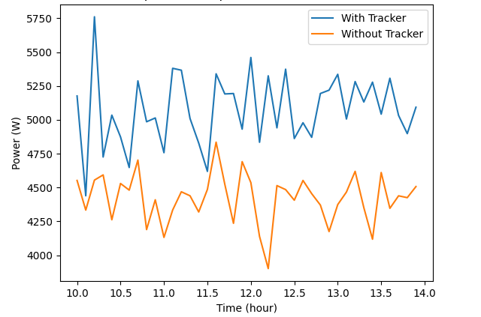
POWER OUTPUT V/S TIME
Observation: The power output is constantly fluctuating in both cases as all factors are variable. However, with tracker curve is always above the without tracker curve therefore ensuring more power output.

Slide 23
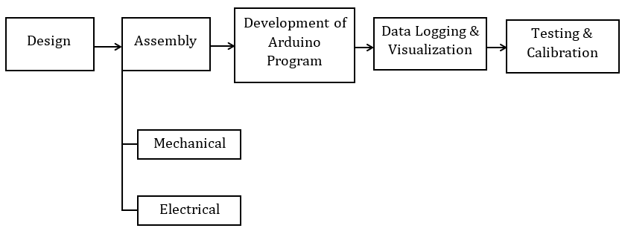
METHODOLOGY

Slide 24

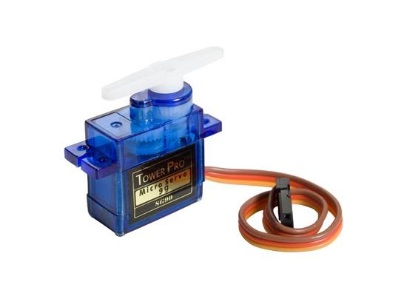
DESIGN
The design process is the first crucial step as it involves determining the necessary components, dimensions, and placement of the system. This step ensures that the solar tracking system is functional, efficient, and safe for operation. The various components used in the design of the system are:
Arduino UNO R3 is a microcontroller used here which will serve as the brain of the system and is collectively termed as the memory and control unit (MCU).
Servo Motors are used for movement and controlling the direction of the solar panel.

Slide 25
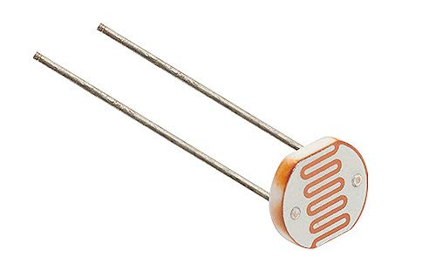
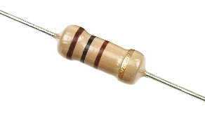
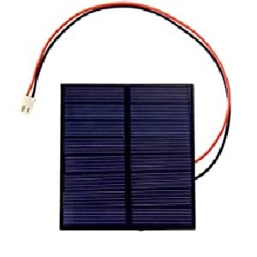
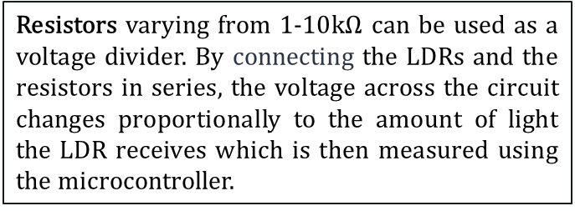
Light-Dependent Resistors (LDRs) are photoresistors used to detect the intensity and direction of incident solar radiation to track the position of the sun.
Resistors varying from 1-10$kΩ$ can be used as a voltage divider. By connecting the LDRs and the resistors in series, the voltage across the circuit changes proportionally to the amount of light the LDR receives which is then measured using the microcontroller.
Solar Cell (5V-1.5W) are mounted on the solar tracker and capture sunlight to generate electricity.

Slide 26
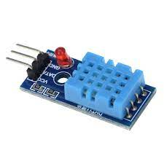
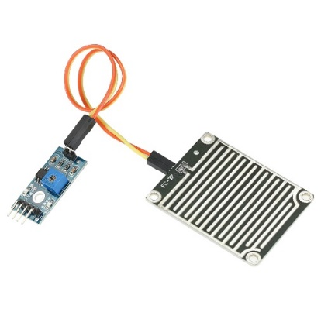
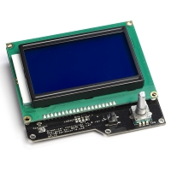
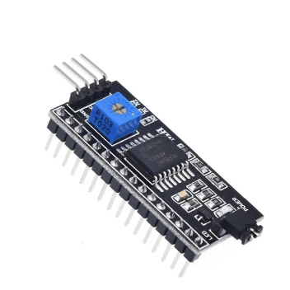
Weather-Monitoring Components
DHT11 sensor for monitoring the temperature and humidity
Rainfall sensor for monitoring precipitation levels
LCD screen for displaying the output
I2C Module for connecting all of these components to the MCU

Slide 27
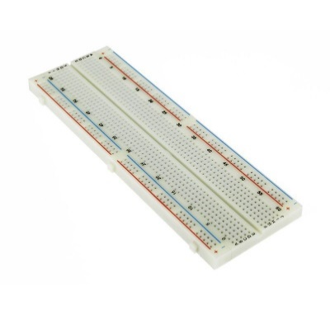
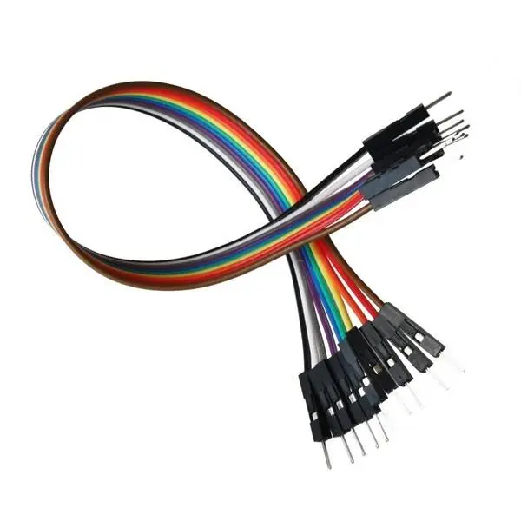
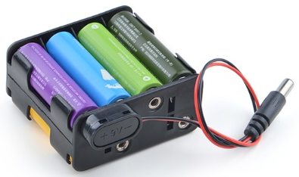

A breadboard is required to assemble and connect the various components of the system.
Jumper wires are used for making connections between the components on the breadboard
A power source, such as a battery or adapter is required to power the Arduino UNO board, motors, and sensors.
The framework of the entire assembly which will provide a neat and organized appearance is made using hardware such as PVC board or foamboard

Slide 28
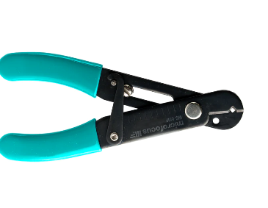
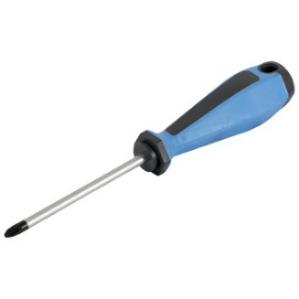
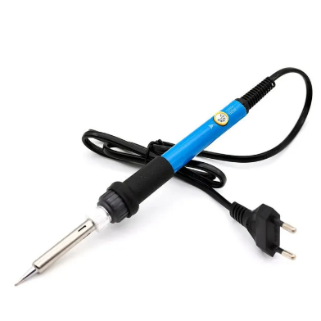
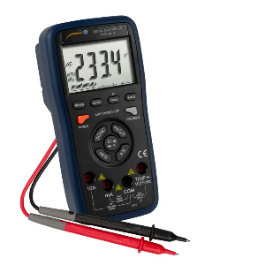
Basic Tools
Screwdriver for tightening or untightening nuts and bolts
Wire stripper for removal of insulation of wires
Soldering iron for joining electrical components
Digital Multimeters for continuity testing

Slide 29
ASSEMBLY
Assembly is the next crucial step as it involves the actual construction of the system from the individual components identified during the design phase. It is of two types namely mechanical assembly and electrical assembly
Mechanical assembly involves the physical construction of the system involving constructing a sturdy frame to support the solar cell and sensors, along with mounts for the motors that will drive the movement of the solar cell. This may require cutting and shaping the construction hardware, drilling holes for bolts or screws, placing couples and brackets for components and other aspects.
Electrical assembly is concerned with installation of electronic components and proper wiring to create a functional system. This involves tasks such as soldering of wires to breadboards, making electrical connections of sensors with jumper wires and proper installation of power supplies, switches, motors and other circuitry components for the system to operate as intended.
ASSEMBLY

Slide 30
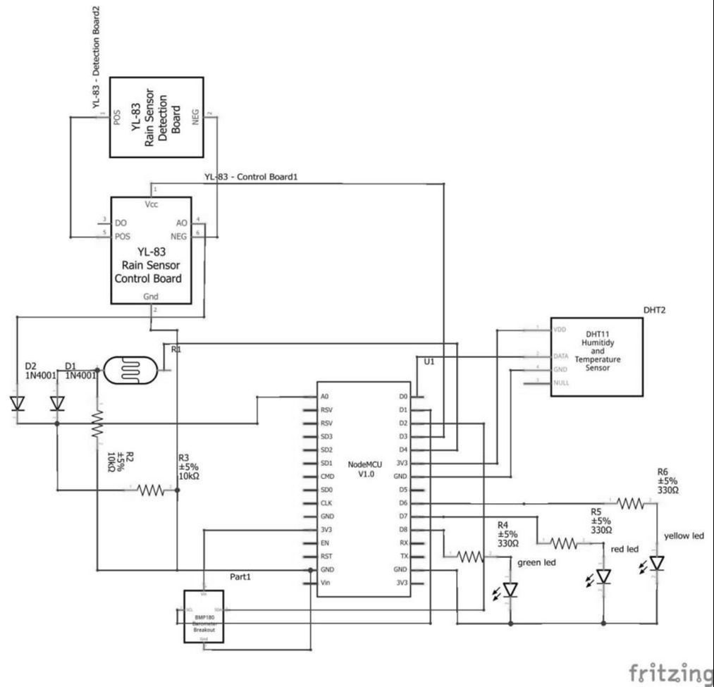
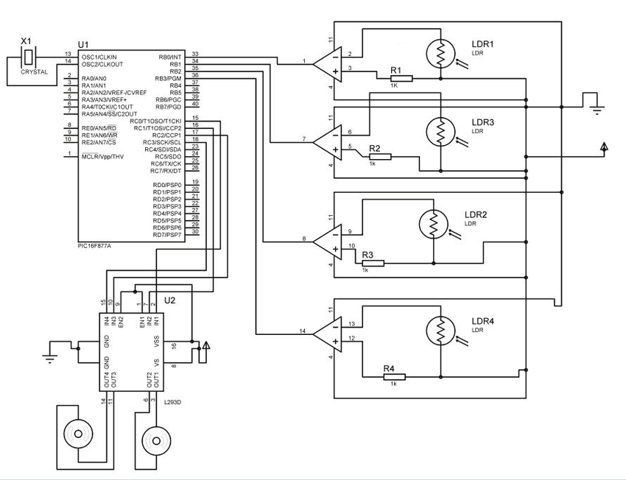
Schematic Circuit Diagrams
Solar-tracking Circuit
Weather-Monitoring Circuit

Slide 31
DEVELOPMENT OF ARDUINO PROGRAM
Development of Arduino program is the third crucial step which involves developing the necessary code for the microcontroller to process the inputs from the sensors and control the motors. Arduino IDE (Integrated Development Environment) interface is used for programming the Arduino UNO board. The steps associated in this process are:
The Arduino programming language is based on C++, and the code is typically written in IDE.
The code for the solar tracking system typically involves reading data from the various sensors, calculating the position of the sun, and adjusting the orientation of the solar panel accordingly.
The Arduino code also includes the logic for the weather-monitor, which determines whether the system should be shut down in case of extreme weather conditions.
Once the code has been written, it is uploaded to the Arduino microcontroller using a USB cable or wireless connection.

Slide 32
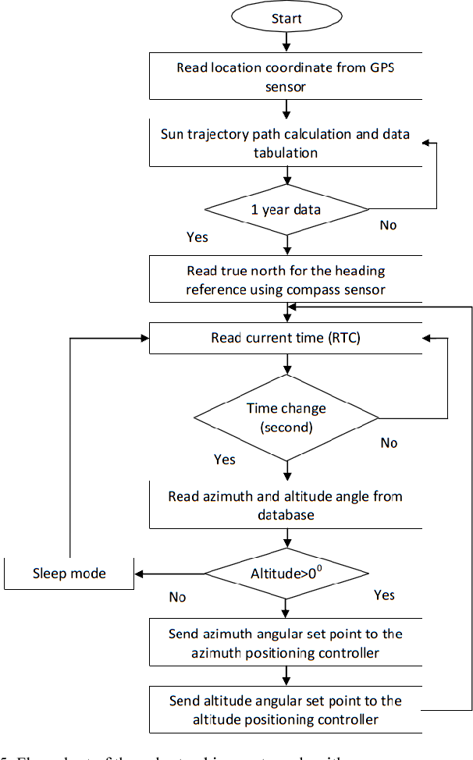
FLOWCHART OF POSITIONING ALGORITHM

Slide 33
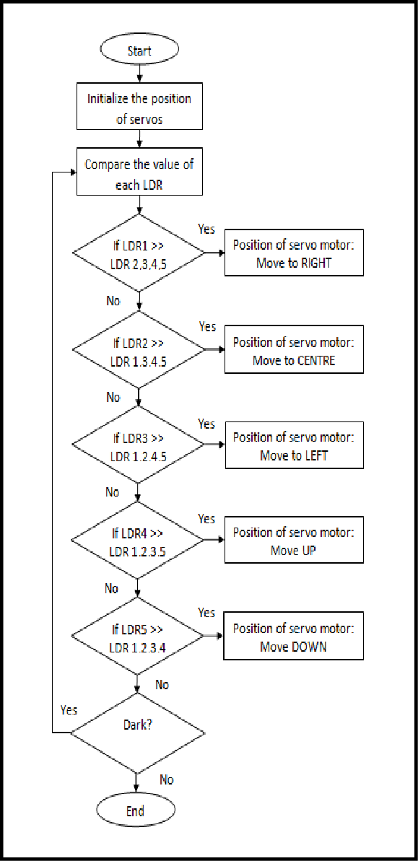
FLOWCHART OF LDR SENSING AND MOTOR ACTUATION ALGORITHM

Slide 34
DATA LOGGING AND VISUALIZATION
Data logging involves feeding some input and then collecting data from the sensors and components of the system and thereafter storing it in a database. This data includes information such as the system's orientation, LDR reading, the amount of solar radiation received, system's power output, weather-monitoring data, etc.
Visualization refers to the process of presenting the data collected from the system in a tabular and/or graphical format. This can include charts, graphs (bar, line, histograms), and other visual representations of the system's performance.
By logging and visualizing the data, it becomes easier to identify any patterns or trends in the system's performance and to determine whether any adjustments need to be made.

Slide 35
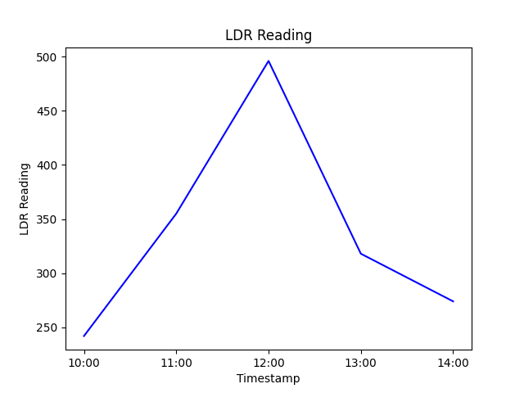
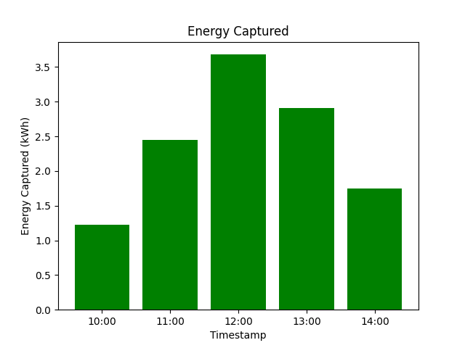
DATA SAMPLE

Slide 36
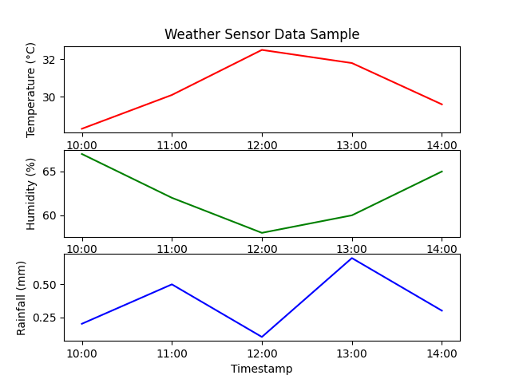
DATA SAMPLE

Slide 37
TESTING AND CALIBRATION
This is the final step involved. Testing involves verifying whether the system is functioning as intended. Through testing, any issues with the system can be identified and corrected beforehand. This helps to minimize downtime and reduce the risk of damage or failure.
Motor & Sensor Testing: The motors used in the system should be tested to ensure that they are functioning properly and can handle the load of the solar panel. The sensors used in the system should be tested to ensure that they can accurately detect changes properly.
MCU Testing: The MCU used in the system should be tested to ensure that it can accurately process data from the sensors and control the movement of the solar panel.
Continuity Testing: It is used for testing an electrical circuit to determine whether the current flows through it without interruption. It is done to check if there are any breaks or short circuits in the wiring using a digital multimeter. The beep sound in the multimeter ensures continuity between the connected test points in the circuit.

Slide 38
Calibration involves adjusting the system appropriately to ensure that the system is measuring and responding accurately. It is essential for accurate measurements and performance, which is critical for the overall success of the system.
Motor Calibration: This involves measuring and adjusting various motor characteristics such as speed, torque, current, and voltage to ensure that the motor is operating at its maximum efficiency and performance.
Sensor Calibration: This involves adjusting the sensitivity of the sensors.

Slide 39
WORKING

Slide 40
WORKING PRINCIPLE OF A SOLAR TRACKER
The principle on which the idea of solar tracking is based is known as Maximum Power Point Tracking (MPPT). This technique is used in solar PV systems to optimize the power output from the solar panels. The MPPT system uses a control algorithm that continuously adjusts the load impedance to obtain the maximum power output from the solar panels.
The Maximum Power Point (MPP) is the point on the I-V curve of a solar panel where the product of current and voltage is maximum, resulting in the highest power output. In other words, it is the point at which a solar panel operates most efficiently and produces the maximum amount of power for a given amount of solar radiation.

Slide 41
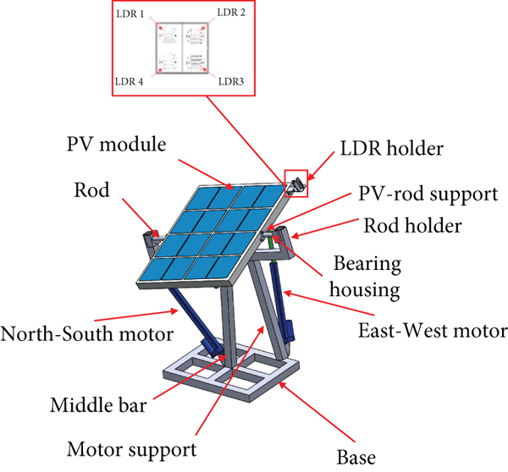
PARTS OF AN ACTUAL DUAL-AXIS SOLAR TRACKER

Slide 42
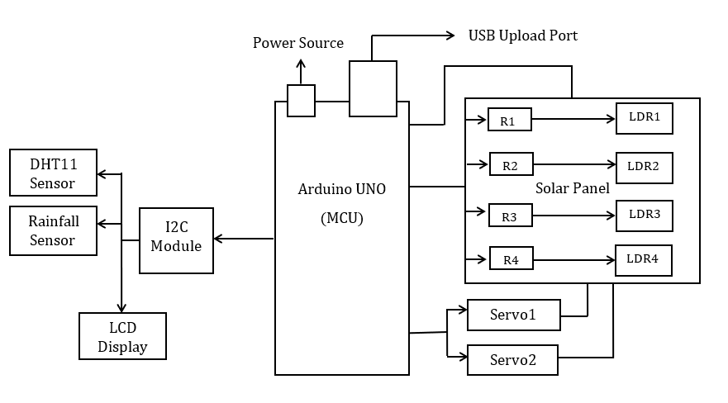
SCHEMATIC BLOCK DIAGRAM

Slide 43
OPERATING MECHANISM OF SOLAR TRACKER
The solar radiation is incident on the solar cell which is detected by the four LDRs. The resistance of LDR decreases as the intensity of light increases, and this change in resistance can be used to measure the intensity of light. Resistors varying from 1-10 kΩ is used to limit the current flowing through the LDR, which helps to ensures stable output voltage of the circuit. The data from the LDR is sent to the MCU as analog signals and it then converts it into digital signals which is processed by the Arduino program. This relays the information to actuate the movement of two servo motors (along two axes) which continuously adjusts the orientation of the solar panel accordingly as the sun moves across the sky. This maximizes the amount of solar radiation that is incident on the solar panel thereby improving its efficiency.

Slide 44
OPERATING MECHANISM OF weather monitor
The DHT11 (Digital Humidity and Temperature Sensing v. 11) sensor measures the temperature (in C) and humidity (in %), while the rainfall sensor measures the precipitation levels (in mm). Both sensors are connected to the Arduino using the I2C (Inter-integrated circuit) module. The I2C protocol is used to communicate between the Arduino and the sensors. The MCU then reads the data from the sensors and displays the output on an LCD screen. The collected data is processed by the MCU via an Arduino algorithm, and then visualized using tools such as Matplotlib (a plotting library for the Python programming language).

Slide 45
WORKING OF SENSORS

Slide 46
LDR
The working of an LDR is based on the property of semiconductors, which is that their electrical conductivity can be changed by varying the amount of light energy that is absorbed by them. In an LDR, the semiconductor material used is typically CdS.
When light photons strike the surface of the LDR, they transfer energy to the electrons in the semiconductor, allowing them to break free from their atoms and become mobile. This creates more electron-hole pairs, which increases the number of free charge carriers in the material, thereby reducing its resistance.
When the LDR is exposed to bright light, its resistance drops to a low value, which allows more current to flow through it. Conversely, when it is in the dark or exposed to very low levels of light, its resistance increases to a high value, which reduces the amount of current that flows through it.

Slide 47
DHT11 SENSOR & RAINFALL SENSOR
The DHT11 sensor consists of two parts-a humidity-sensitive capacitor and a thermistor. The sensor works by detecting changes in the capacitance of a thin-polymer film on absorption of moisture. Further, the thermistor which is made up of a temperature-sensitive ceramic, changes its resistance in response to change in temperature. The MCU then measures these changes in analog form and converts them into appropriate temperature and humidity digital readings.
The rainfall sensor works on the principle of water conductivity. The sensor consists of two conductive plates that are separated by a small gap. When raindrops fall between the plates, the water creates a conductive path between the plates, allowing a small amount of current to flow. The amount of current is then measured by the MCU to determine the intensity of the rainfall.

Slide 48
ADVANTAGES AND LIMITATIONS

Slide 49
ADVANTAGES
Increased Energy Output: Solar tracking panels can track the movement of the sun throughout the day, positioning themselves to catch the most sunlight possible. They can capture sunlight at the ideal angle by continuously altering their position, which increases energy production compared to fixed panels. Depending on the precise design and location, studies have shown that solar tracking systems can improve energy output by 20% to 40% or more.
Extended Solar Window: Fixed solar panels only receive direct sunlight for a short period of time each day, usually from mid-morning to mid-afternoon when the sun is at its zenith. Solar tracking panels, in contrast, can continually shift their position to capture sunlight from sunrise until sunset. By extending the solar window, energy can be produced for a longer period, making the most of the available daylight.

Slide 50
Enhanced ROI (Return on Investment): Although solar tracking systems may be more expensive initially and need more intricate installation than fixed panels, over time their higher energy output can lead to a higher return on investment. Particularly in areas with high electricity rates or in which space is at a premium, the additional energy produced by monitoring panels might balance the initial expenditure and result in quicker payback times.
Higher Energy Density: Solar tracking panels provide more energy per unit area, maximizing the usage of available space. set panels may have shade or space restrictions and occupy a set location. Tracking systems, on the other hand, can make better use of available space by moving with the sun, reducing the impacts of shade, and increasing energy density.

Slide 51
LIMITATIONS
It's important to keep in mind that solar tracking systems could also have some drawbacks, like greater initial costs and potential dependability difficulties.
Higher Initial Costs: Compared to fixed solar panels, solar tracking systems are typically more expensive to install. The system's initial expenses are raised by the extra parts and mechanisms needed for tracking. Due to this, solar tracking may not be as economically viable for some projects or installations with limited funding.
Dependability and Strength Concerns: Moving parts in solar tracking systems create more possible failure spots. Over time, mechanical parts like motors and gears may need to be replaced or repaired, lowering the system's overall reliability. The tracking system may experience greater wear and tear due to exposure to the environment and constant movement, which could shorten its lifespan.

Slide 52
Why this project is beneficial?
This project makes sure that clients can get the most out of their solar system, which has a big impact on their energy savings and lowers their carbon footprint. Solar tracking panels offer a future-proof investment that combines sustainability, efficiency, and long-term financial rewards, enabling customers to embrace a greener and more prosperous energy future. They can adjust to a variety of weather situations and have scalable design possibilities.

Slide 53
ESTIMATED BUDGET FOR PROTOTYPING

Slide 54
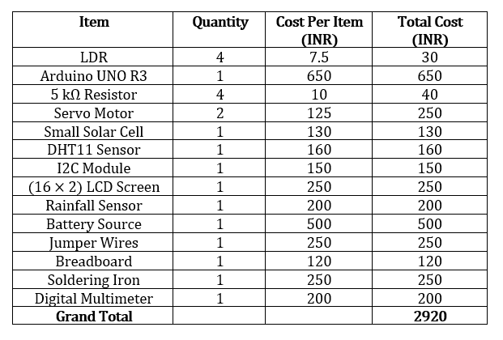
COST BREAKDOWN PER COMPONENTS/TOOLS

Slide 55
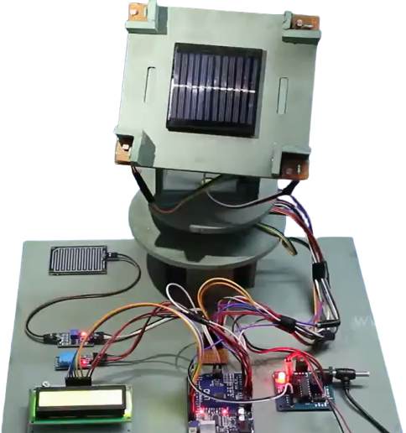
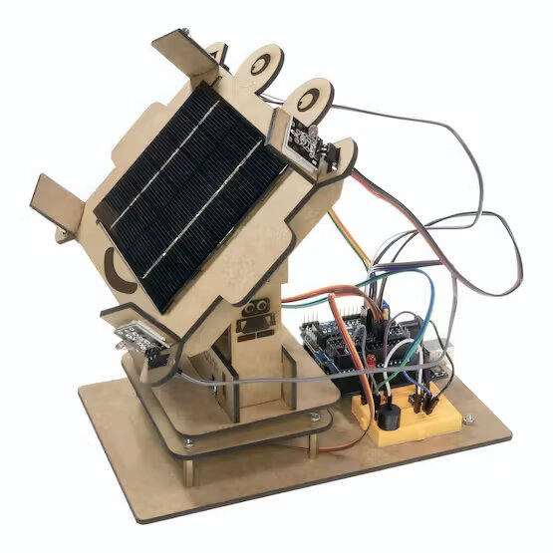
sample PROTOTYPES

Slide 56
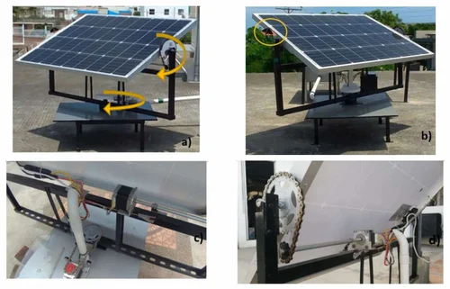
PRACTICAL-USE SOLAR TRACKERS

Slide 57
REFERENCES (WEB-SOURCED)
1. Nevon Projects, retrieved from https://nevonprojects.com/dual-axis-solar-tracking-system-with-weather-sensor/
2. Arduino. (n.d.). Official Arduino Website. Retrieved from https://www.arduino.cc/
3. Takeoff Projects, retrieved from https://takeoffprojects.com/project-details/Dual-Axis-Solar-Tracking-System-with-Weather-Monitoring--12577
4. IOT Project Ideas, retrieved from, https://iotprojectsideas.com/dual-axis-solar-tracker-arduino-project-using-ldr-servo-motors/
5. Mechanical Farm, retrieved from, https://www.mechanical-farm.com/dual-axis-solar-tracking-system-using-arduino/
6. IEEE, retrieved from, https://ieeexplore.ieee.org/document/9742876
7. Sunfounder. (n.d.). Arduino-based Sun Tracking Solar Panel. Retrieved from https://www.sunfounder.com/learn/Arduino-based-Sun-Tracking-Solar-Panel.html

Slide 58
REFERENCES (RESEARCH & CONFERENCE PAPERS)
1. R. Madhupriya, S.M. Ahuja, and Maitri Saini, "Design and implementation of solar tracking system using Arduino," 2017 International Conference on Innovations in Information, Embedded and Communication Systems (ICIIECS), Coimbatore, India, 2017, pp. 1-6.
2. T.M. Thamizh Thentral, Meghna Kannan, VS Mounika, Mahima Nair, ISSN: 2277-3878, Volume-8, September 2019 International Journal of Recent Technology and Engineering (IJRTE)
3. P. V. P. Jayanthi and G. K. Karthick, "Design and implementation of an automatic solar tracking system using Arduino," 2017 IEEE Calcutta Conference (CALCON), Kolkata, India, pp. 10-14.
4. Goutam Barma, P. Uday Kiran, B. Balaram,G. Vamshi Krishna, International Research Journal of Engineering and Technology (IRJET), ISSN: 2395-0056 Volume 9, Issue 6 (Jun 2022)
5. Ankit Makwana and Devang Lad, Dept. of Electrical Engineering, Sardar Vallabhbhai Patel Institute of Technology, Vasad, Gujarat, India, International Journal of Current Engineering and Technology E-ISSN 2277 – 4106, P-ISSN 2347 – 5161
6. A. Bhadoria, R.K. Mathur, and Devesh Chaudhary Singh, "Design and implementation of solar tracking system using Arduino for maximum solar energy generation," 2016 IEEE Uttar Pradesh Section International Conference on Electrical, Computer and Electronics Engineering (UPCON), Allahabad, India, 2016.

Slide 59
THANK YOU !

